Slide 1
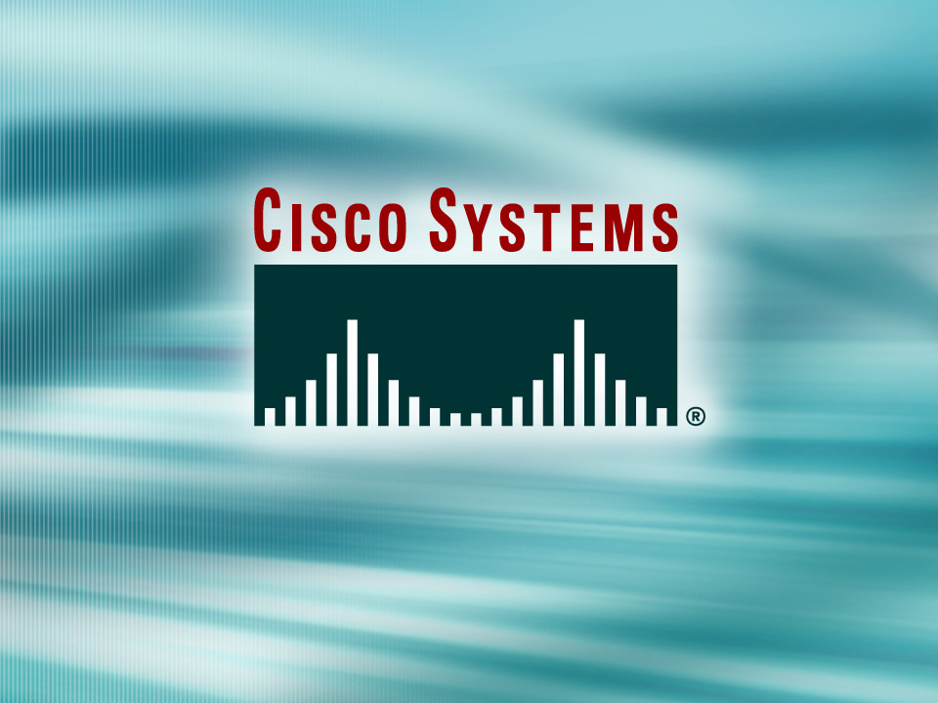
© 2002, Cisco Systems, Inc. All rights reserved.

Slide 2

Redundant Topology Overview
© 2002, Cisco Systems, Inc. All rights reserved.
Notes:
Purpose: This chapter introduces the Cisco IOS™ CLI on the Catalyst® 1900 switch and router.
Timing: This chapter should take about 2 hours to present.
Note: The Catalyst 1900 switch only has a subset of the router Cisco IOS commands available.
Contents:
Introduction to Cisco IOS. Explain to the student what is IOS?
Cisco Device startup procedures in general.
IOS configuration source.
General introduction to the IOS CLI.
Cat 1900 switch startup procedures.
Intro to Cat 1900 CLI. This part covers the basic configuration on the switch, like setting the IP address and hostname. More details about the various Cat 1900 switch configuration commands are explained in Chapter 6 and 7.
Router startup procedures. More details on the router startup process is discussed in chapter 5.
Router IOS CLI.

Slide 3
Objectives
Upon completing this lesson, you will be able to:
  Describe the features of redundant switch and bridge topologies
  Explain the problems associated with broadcast storms, multiple frame transmissions, and MAC address table instability
  Describe loop avoidance and explain how it can solve redundant switch topology issues
Notes:
Slide 1 of 2
Purpose: This slide states the chapter objectives.
Emphasize: Read or state each objective so that each student has a clear understanding of the chapter objectives.
Note: Catalyst switches have different CLIs. The Catalyst 2900xl and the Catalyst 1900 has a Cisco IOS CLI. The Cisco IOS CLI commands available on the 2900xl is different from the 1900. The Catalyst 5000 family has no Cisco IOS CLI, and use the set commands instead. This class only covers the configuration on the Catalyst 1900 switch.

Slide 4
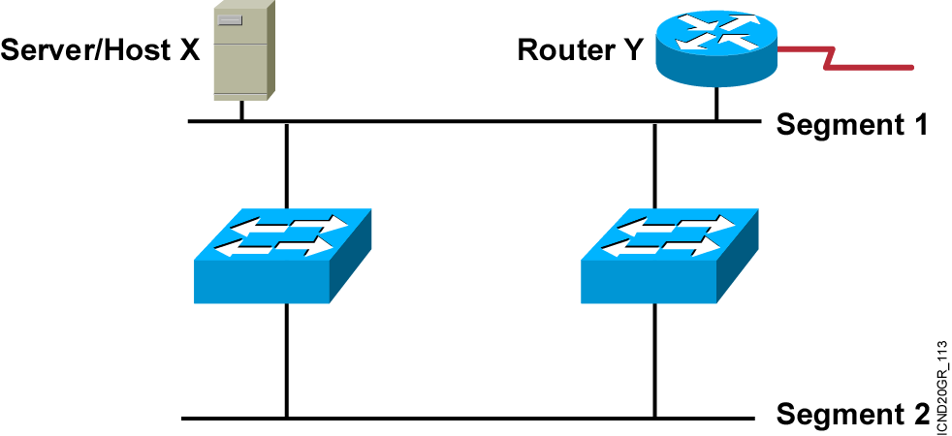
Redundant Topology
  Redundant topology eliminates single points of failure.
  Redundant topology causes broadcast storms, multiple frame copies, and MAC address table instability problems.
Notes:
Emphasize: Layer 2 has no mechanism (like a TTL) to stop loops.

Slide 5
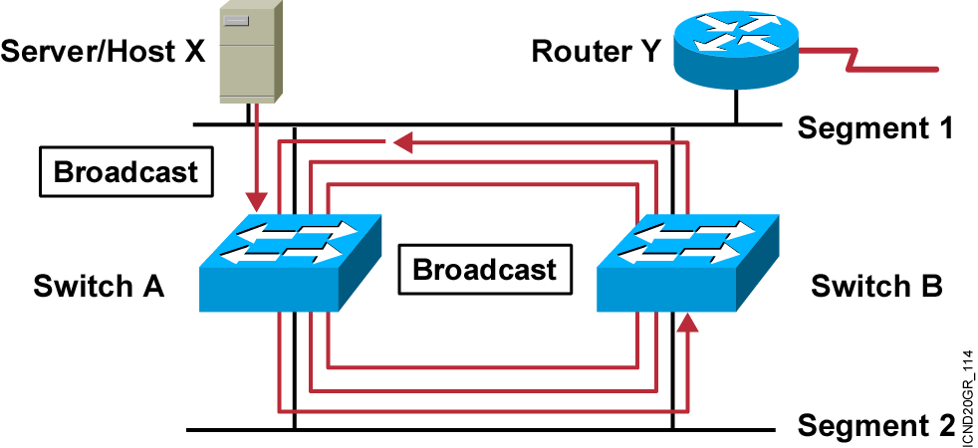
Broadcast Storms
  Host X sends a broadcast.
  Switches continue to propagate broadcast traffic over and over.
Notes:
Layer 3 of 3
Emphasize: Layer 2 has no TTL mechanism to stop looping frames.

Slide 6
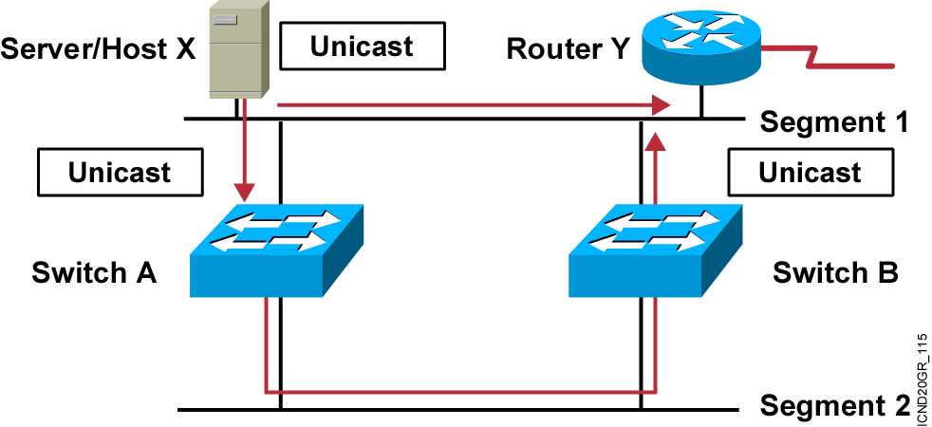
Multiple Frame Copies
Host X sends a unicast frame to router Y.
MAC address of router Y has not been learned by either switch yet.
Router Y will receive two copies of the same frame.
Notes:
Layer 2 of 2

Slide 7
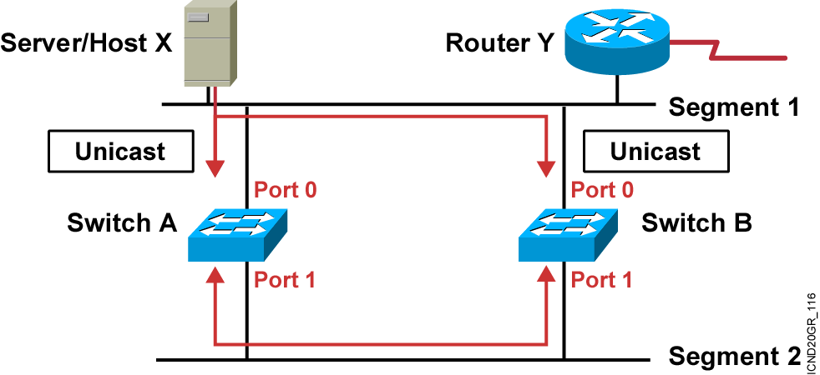
MAC Database Instability
Host X sends a unicast frame to router Y.
MAC address of router Y has not been learned by either switch.
Switches A and B learn the MAC address of host X on port 0.
The frame to router Y is flooded.
Switches A and B incorrectly learn the MAC address of host X on port 1.
Notes:
Layer 2 of 2

Slide 8
Summary
  Bridged and switched networks are commonly designed with redundant links and devices, which can introduce problems, such as broadcast storms, multiple frame transmission, and MAC database instability.
  A broadcast storm is when each switch on a redundant network floods broadcast frames endlessly.
  In a redundant topology, multiple copies of the same frame can arrive at the intended host, potentially causing problems with the receiving protocol.
  MAC database instability results when multiple copies of a frame arrive on different ports of a switch.
Notes:
Purpose: This slide discuss the initial configurations on the routers and switches.
Note: There is no setup mode on the Catalyst 1900 switch.

Slide 9
